Slide 1
Cardiac Arrest Detector
ECE 508 Internet of Things
(Group 5)
Kyle Hanks khanks@gmu.edu
Kyle Loyd Guthrie kguthri@gmu.edu
Shamili Mownika Tetali stetali@gmu.edu
Sunanda Roy sroy9@gmu.edu

Slide 2
Project Description
Our goal was to design an IOT device capable of predicting chances of cardiac arrest in a person
The Arduino will accept data from a heart rate monitor and a body temperature sensor. It will then send this data over BLE to an Android application that will plot the data and store it in the cloud via Google Firebase, an app development/cloud storage platform.

Slide 3
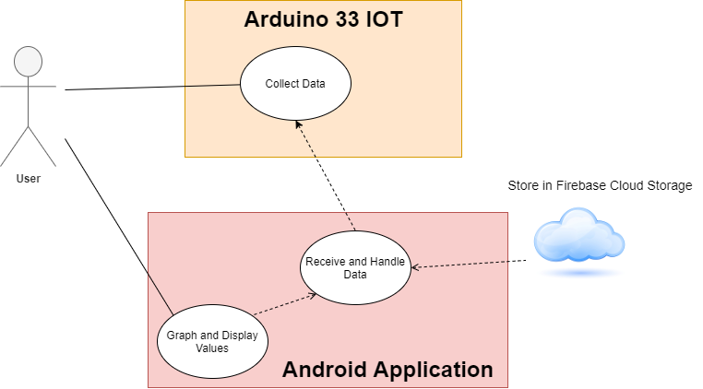
Use Case

Slide 4
Implementation
Technical Solution and IoT System Implementation

Slide 5
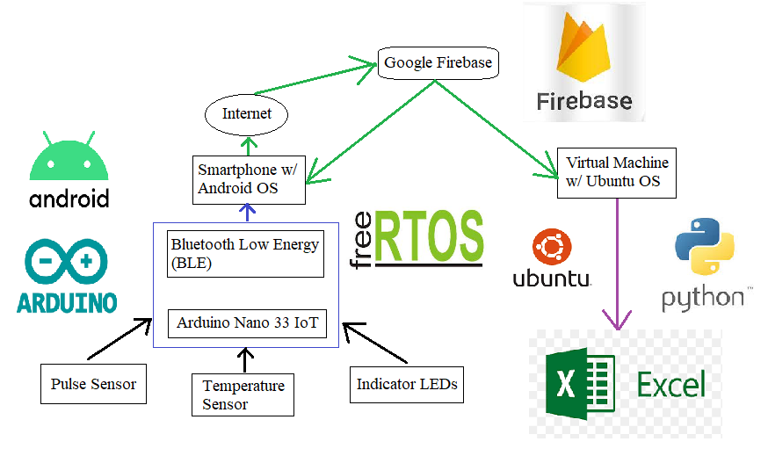
Data Flow Diagram

Slide 6
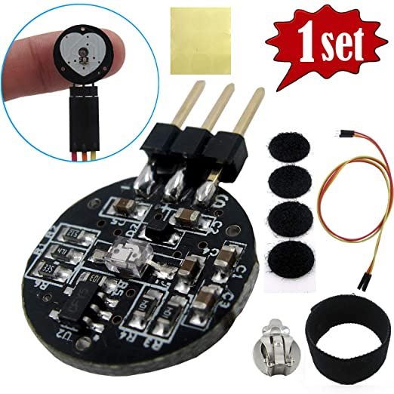
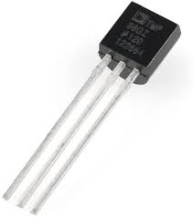
Technical Solution Sense
The edge IoT device used two sensors: the Tragoods pulse sensor/heart rate monitor and the FTCBLock TMP36 temperature sensor.

Slide 7
Technical Solution Compute
The data from the sensors is read in continuously using a multi-threaded RTOS architecture.
The data is then converted to proper format to be sent over BLE.
Sensor readings are converted and rounded off to the nearest integer value before being transmitted as BLE characteristics
BLE characteristics are only transmitted when there is a change from previous reading

Slide 8
Technical Solution Transmit
The sensor readings are transmitted as Arduino BLE objects of type BLEIntCharacteristic to the Android app.
The app captures the exported BLE characteristic readings and converts them to Android objects of type BluetoothGattCharacteristic for processing

Slide 9
Technical Solution Store
The Cloud Firestore database provided by Firebase receives real-time data from the Android.
Due to the asynchronous nature of the Android API (which reads the incoming sensor data over multiple threads), the data are stored to Cloud Firestore storage asynchronously as well.

Slide 10
Technical Solution Retrieve
The Android app is also capable of retrieving data back from cloud storage once a user-specified number of sensor readings has been captured
For plotting the graphs, we use a python script to read values of sensor readings from Firebase and display them using MS Excel

Slide 11
Results
The Arduino is currently capable of reading the values from both sensors and sending the data to the Android app over BLE
The Android app and supporting Python script can read stored values from the cloud after a round of data collection has been completed.
In future, this retrieved data can be plotted into a graph on the app’s user interface itself for subsequent analysis
Future work would include further research of IoT sensors to improve accuracy of the data collected.

Slide 12
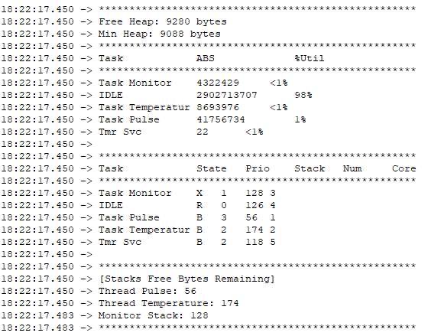
RTOS task usage

Slide 13
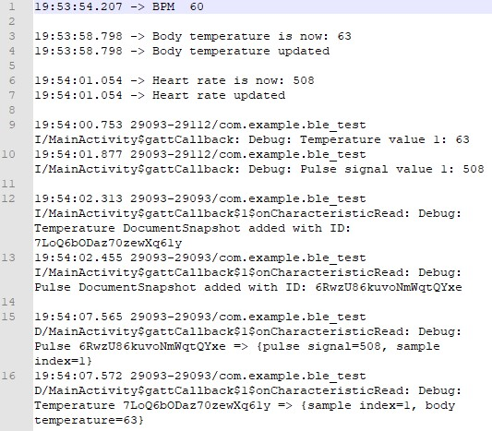
Data flow of a sample reading

Slide 14
Output waveforms (100 samples)

Slide 15
Multi-Threaded Sensor Reading and Google Firebase Cloud Storage
LED coding guide:
LED_BUILTIN – Temperature sensor reading.
WHITE LED (D16) – Pulse sensor reading.
BLUE LED (D20) – BLE peripheral device (Arduino) connected.

Slide 16
References
1. Pulse Sensor Playground [https://github.com/WorldFamousElectronics/PulseSensorPlayground]
2. TMP36 Temperature Sensor
[https://learn.adafruit.com/tmp36-temperature-sensor]
3. The Ultimate Guide to Android Bluetooth Low Energy [https://punchthrough.com/android-bleguide/]
4. Android Developer Guides [https://developer.android.com/guide]
5. Add Firebase to your Android project [https://firebase.google.com/docs/android/setup]
6. Cloud Firestore [https://firebase.google.com/docs/firestore]
7. Python Client for Google Cloud Firestore [https://googleapis.dev/python/firestore/latest/index.html]

